Slide 1
C-STORE OFFICE
ADVANCED ACCOUNTING – Accounts Payable

Slide 2
Agenda
What does Accounts Payable mean?
Where can I find Accounts Payable in C-Store Office?
How do I pay invoices?
Do I have options to get invoices into C-Store Office?
Why is Accounts Payable important?

Slide 3
WHAT DOES ACCOUNTS PAYABLE MEAN?
A section of the accounting department that is responsible for processing vendor invoices and other bills for goods and services that a company received on credit.
The title of the current liability account containing the amounts owed for vendor invoices and other bills that have been approved but not yet paid. The balance in accounts payable is expected to be a credit balance.
*Hint Accounts PAY-able – You are paying for goods or services

Slide 4
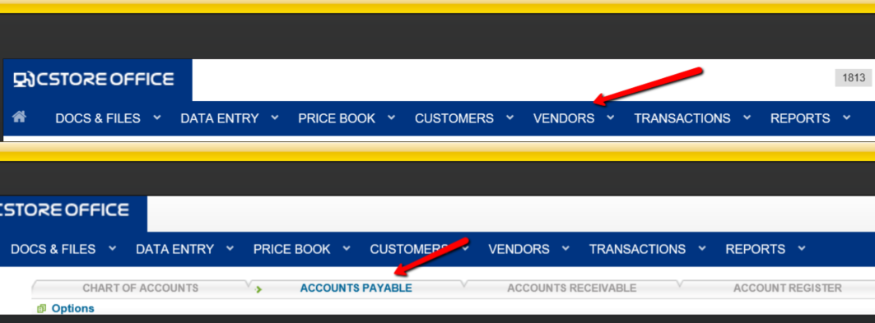
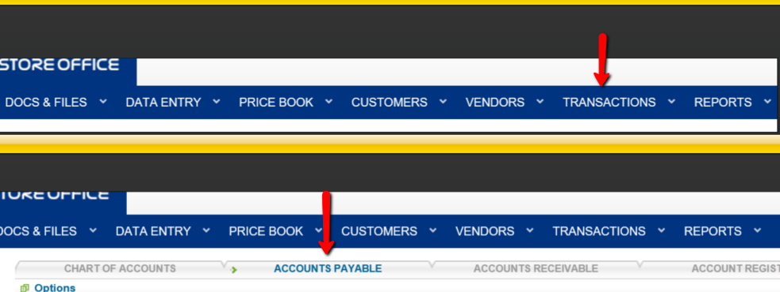
WHERE IS ACCOUNTS PAYABLE LOCATED IN CSTORE?
Option 1: Vendors > drop down icon > Accounts Payable
Option 2: Transactions > drop down icon > Account Register > Accounts Payable tab
Option 1
Option 2

Slide 5
HOW DO I PAY AN INVOICE?
Step 1: To retrieve the invoices, select the Company, Class, Vendor, Account, and Date values.
Step 2: To select the invoice, select the check box.
*You may partially pay for invoices as well. Type in the amount to pay, click once outside of the box and the new amount will appear.

Slide 6
HOW DO I PAY AN INVOICE?
Step 3: Input Payment Attributes.

Slide 7
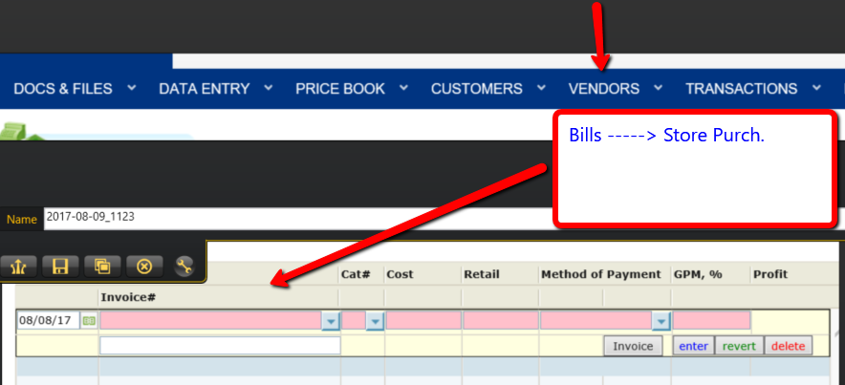
DO I HAVE OPTIONS TO GET INVOICES INTO C-STORE OFFICE?
Option 1: Petrosoft can manually input scanned invoices into the system through EDI.
Option 2: Manually put in the invoices: Vendors > drop down icon > Bills > drop down icon > Store Purch.

Slide 8
WHY IS ACCOUNTS PAYABLE IMPORTANT?
C-Store Office is based off of purchases, which means it needs to know what inventory and cash is moving in and out of the business to calculate accurate reports, inventory, and journal entries.
Providing accurate and timely purchases in C-Store Office will promote strong organization in your account.

Slide 9
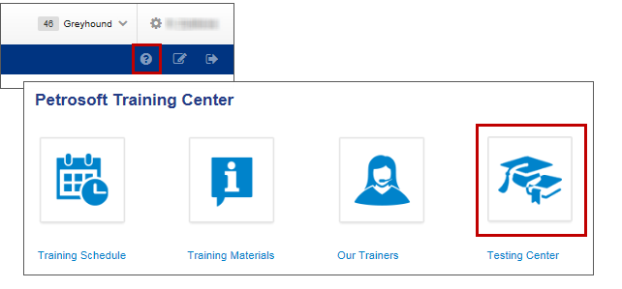
TRAINING CENTER
For additional testing on what you have learned, please refer to our new “Testing Center”.
To access this new feature, click the help icon, and then select Testing Center.
For additional information, please refer to the Accounts Payable section at Petrosoft Cloud Help. Go to C-Store Office > Accounting > Accounting Module in C-Store Office > Accounts Payable.

Slide 10
THANK YOU FOR YOUR TIME!
Get in Touch
www.cstoreoffice.com
Petrosoft LLC
290 Bilmar Drive
Pittsburgh, PA 15205
1.412.306.0640

